Slide 1
AIRLINE QUALITY ANALYSIS FOR BRITISH AIRWAYS
A DATA ANALYSIS REPORT

Slide 2
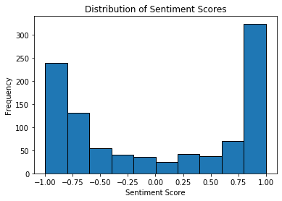
Analysis Findings
According to my data findings, most reviews are positive. The average of the positive value is 0.0103 and the average of the negative value 0.082. The average value of the compound (the negative and positive combined) is 0.034.
Below is a graph showing the findings
As seen from the histogram, most reviews are on the positive side with a number of negative reviews.

